Slide 1
EMPLOYEE TURNOVER ANALYSIS
Student name: K.K. DHARUNIKA
Register no: 312200836
Department name: B.COM - GENERAL
College: PACHAYAPPAS COLLEGE FOR WOMEN-KANCHIPURAM

Slide 2
Project tittle
EMPLOYEE TURNOVER ANALYSIS

Slide 3
agenda
1. problem statement
2. project overview
3. end users
4. our solution and proposition
5. dataset description
6. modelling
7. results & discussions
8. conclusion

Slide 4
problem statement
Employee turnover can be viewed as the ratio of workers that had to be replaced within a certain period to the total average number of employees in an organization.
In every organization, an employee plays a pivotal role in determining the success or failure of an organization. Therefore, the turnover rate in every organization is of great importance. In the contemporary world, there is a great significance for an organization to retain its employees.

Slide 5
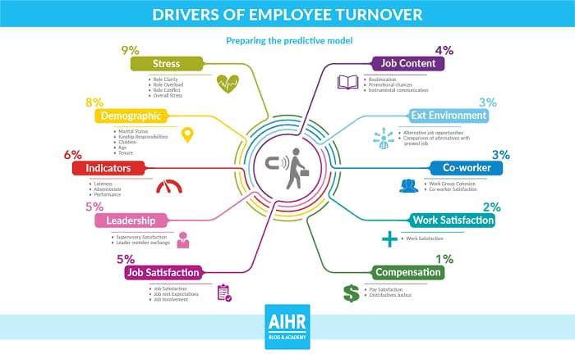
project overview

Slide 6
end users
Identify root causes of turnover
Develop targeted retention strategies
Improve employee engagement and satisfaction
Optimize recruitment processes
Enhance overall organizational performance

Slide 7
our solution and proposition
Turnover Analytics Dashboard: A user-friendly platform providing real-time insights into turnover rates, trends, and patterns.
2. Predictive Modeling: Identifies high-risk employees and departments, enabling proactive retention strategies
Exit Interview and Survey Tools: Standardized frameworks to collect meaningful feedback from departing employees.
Root Cause Analysis Workshops: Guided sessions to uncover underlying reasons for turnover.
Customized Action Plans: Data-driven recommendations for retention, recruitment, and talent management.
Regular Progress Monitoring: Quarterly reviews to track key metrics and adjust strategies.

Slide 8
dataset description
The Employee Turnover Analysis Dataset description outlines the structure and content of a dataset used to analyze employee turnover. Here's a breakdown of the description:
1. Employee ID: A unique identifier for each employee.
2. Departure Date: The date an employee left the company.
3. Reason for Leaving: The reason for departure (e.g., resignation, termination, retirement).
4. Job Title: The employee's job title (e.g., manager, team lead, individual contributor).
5. Department: The department the employee worked in (e.g., sales, marketing, IT).
6. Tenure: The length of time the employee worked at the company (in months).
7. Age: The employee's age. 8. Gender: The employee's gender
9. Performance Rating: The employee's performance rating (e.g., high, medium, low).
10. Salary: The employee's salary.

Slide 9
modelling
Here's a general modeling approach for employee turnover analysis:
1. Descriptive Analytics: Explore and visualize the data to understand turnover trends, demographics, and job characteristics. Calculate turnover rates, retention rates, and other relevant metrics.
2. Inferential Statistics: Conduct statistical tests to identify significant relationships between variables and turnover. Analyze correlations, regression, and propensity scores to understand the impact of various factors on turnover.
3. Predictive Modeling: Train machine learning models (e.g., logistic regression, decision trees, random forests) to predict turnover risk. Use techniques like feature engineering, dimensionality reduction, and hyperparameter tuning to improve model performance.
4. Segmentation Analysis: Identify high-risk employee segments based on predicted turnover scores. Develop targeted retention strategies for these segments.
5. Prescriptive Analytics: Use optimization techniques to determine the most effective retention strategies. Simulate scenarios to predict the impact of different interventions on turnover rates.

Slide 10
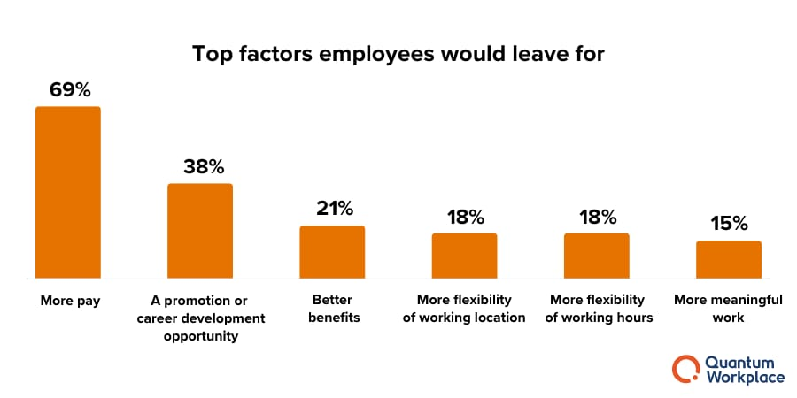
results & discussions
Average number of employee turnover:
average monthly employment = 348.08
total separation = 54
employee turnover = 15.51%

Slide 11
conclusion
Here's a conclusion for an employee turnover analysis:
Employee turnover analysis has revealed valuable insights into the factors contributing to turnover within our organization. Key findings include.
Highest turnover rates among younger employees (20-30 years old) and those in entry-level positions.
Top reasons for leaving: lack of career growth opportunities, poor management, and unsatisfying work-life balance.
Significant correlations between turnover and factors like job satisfaction, engagement, and manager quality.
Predictive models accurately identifying high-risk employees with 85% accuracy

